Slide 1


Data base 2
Project documentation
Canali Davide - 10674880
Cordioli Matteo - 10611332

Slide 2
Index
Specification
Revision of the specifications
Conceptual (ER) and logical data models
Explanation of the logical model
Trigger design and code
ORM relationship design
Entities code
Interface diagrams or functional analysis of the specifications
List of components
Motivations of the components design (if needed)
UML sequence diagrams (only for salient events)
Davide Canali – Matteo Cordioli

Slide 3
Specifications 1/2
TELCO SERVICE APPLICATIONS
A telco company offers pre-paid online services to web users. Two client applications using the same database need to be developed.
CONSUMER APPLICATION
The consumer application has a public Landing page with a form for login and a form for registration. Registration requires a username, a password and an email. Login leads to the Home page of the consumer application. Registration leads back to the landing page where the user can log in.
The user can log in before browsing the application or browse it without logging in. If the user has logged in, his/her username appears in the top right corner of all the application pages.
The Home page of the consumer application displays the service packages offered by the telco company.
A service package has an ID and a name (e.g., “Basic”, “Family”, “Business”, “All Inclusive”, etc). It comprises one or more services. Services are of four types: fixed phone, mobile phone, fixed internet, and mobile internet. The mobile phone service specifies the number of minutes and SMSs included in the package plus the fee for extra minutes and the fee for extra SMSs. The mobile and fixed internet services specify the number of Gigabytes included in the package and the fee for extra Gigabytes. A service package must be associated with one validity period. A validity period specifies the number of months (12, 24, or 36). Each validity period has a different monthly fee (e.g., 20€/month for 12 months, 18€/month for 24 months, and 15€ /month for 36 months). A package may be associated with one or more optional products (e.g., an SMS news feed, an internet TV channel, etc.). The validity period of an optional product is the same as the validity period that the user has chosen for the service package. An optional product has a name and a monthly fee independent of the validity period duration. The same optional product can be offered in different service packages.
From the Home page, the user can access a Buy Service page for purchasing a service package and thus creating a service subscription. The Buy Service page contains a form for purchasing a service package. The form allows the user to select one package from the list of available ones and choose the validity period duration and the optional products to buy together with the chosen service. The form also allows the user to select the start date of his/her subscription. After choosing the service packages, the validity period and (0 or more) optional products, the user can press a CONFIRM button. The application displays a CONFIRMATION page that summarizes the details of the chosen service package, the validity period, the optional products and the total price to be pre-paid: (monthly fee of service package * number of months) + (sum of monthly fees of options * number of months).
If the user has already logged in, the CONFIRMATION page displays a BUY button. If the user has not logged in, the CONFIRMATION page displays a link to the login page and a link to the REGISTRATION page. After either logging in or registering and immediately logging in, the CONFIRMATION page is redisplayed with all the confirmed details and the BUY button.
Davide Canali – Matteo Cordioli

Slide 4
Specifications 2/2
When the user presses the BUY button, an order is created. The order has an ID and a date and hour of creation. It is associated with the user and with the service package, its validity period and the chosen optional products. It also contains the total value (as in the CONFIRMATION page) and the start date of the subscription. After creating the order, the application bills the customer by calling an
external service. If the external service accepts the billing, the order is marked as valid and a service activation schedule is created for the user. A service activation schedule is a record of the services and optional products to activate for the user with their date of activation and date of deactivation.
If the external service rejects the billing, the order is put in the rejected status and the user is flagged as insolvent. When an insolvent user logs in, the home page also contains the list of rejected orders. The user can select one of such orders, access the CONFIRMATION page, press the BUY button and attempt the payment again. When the same user causes three failed payments, an alert is created in a dedicated auditing table, with the user Id, username, email, and the amount, date and time of the last rejection.
EMPLOYEE APPLICATION
The employee application allows the authorized employees of the telco company to log in. In the Home page, a form allows the creation of service packages, with all the needed data and the possible optional products associated with them. The same page lets the employee create optional products as well.
A Sales Report page allows the employee to inspect the essential data about the sales and about the users over the entire lifespan of the application:
Number of total purchases per package.
Number of total purchases per package and validity period.
Total value of sales per package with and without the optional products.
Average number of optional products sold together with each service package.
List of insolvent users, suspended orders and alerts.
Best seller optional product, i.e. the optional product with the greatest value of sales across all the sold service packages.
Davide Canali – Matteo Cordioli

Slide 5
Specification interpretation
Employee are already inserted in the DB.
Services are already inserted in the DB
There could be multiple validity period with the same duration but different fee
Davide Canali – Matteo Cordioli

Slide 6
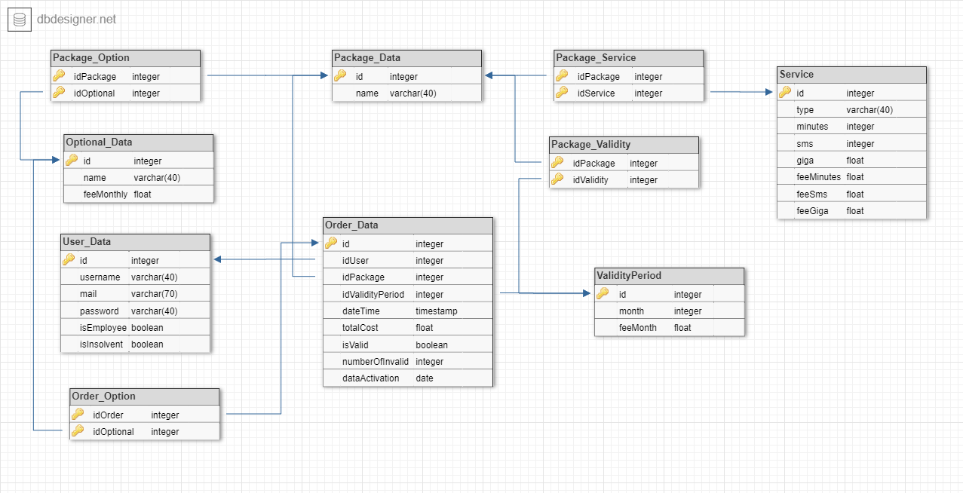
Entity Relationship
N:N
N:N
N:N
N:N
N:N
1:N
N:N
N:N
N:N
N:N
N:N
N:N
N:1
N:N
1:N
N:1
N:1
1:N
1:1
1:N
N:N
N:N
Davide Canali – Matteo Cordioli

Slide 7

Motivations of the ER design
We don’t have a table where we save the info about the start and end date of each service per client since they’re easily computable. We decided to use a view table because all the data needed are already stored in our DB.
Each package as multiple optional, service and validity that represent the choices between which the user can pick
Order data is link with optional and validity to save the user choices among the available ones
To answer the required queries we save the data in 5 materialized view populated by trigger when a specific event occur
Davide Canali – Matteo Cordioli

Slide 8
Logical Schema
User_Data(id, username, mail, password, isEmployee, isInsolvent)
Package_Data(id, name)
Optional_Data(id, name, feeMonthly)
Service(id, type, minutes, sms, giga, feeMinutes, feeSms, feeGiga)
ValidityPeriod(id, month, feeMonth)
Order_data(id, idUser, idPackage, idValidityperiod, dateTime, totalCost, isValid, numberOfInvalid, dateActivation)
Package_Optional(idPackage, idOptional)
Order_Option(idOrder, idOptional)
Package_Service(idPackage, idService)
Package_Validity(idPackage, idValidity)
Davide Canali – Matteo Cordioli

Slide 9
Trigger: createSeller
After an insert in the optional_data table
Insert a new row in the seller_optional table of the new inserted optional
CREATE TRIGGER `createSeller`
AFTER INSERT ON `optional_data`
FOR EACH ROW
begin
insert into seller_optional
values(new.id, new.name, new.feeMonthly, 0);
end
Davide Canali – Matteo Cordioli

Slide 10
Trigger: newPackageValidityOrder
After an insert in the order_data table
If the payment has been succesful
Update the count of purchases of that package with that validity period in the purchases_package_validity table
CREATE TRIGGER `newPackageValidityOrder`
AFTER INSERT ON `order_data`
FOR EACH ROW begin
if(new.isValid=1) then
update purchases_package_validity
set numPurc=numPurc+1
where new.idPackage=idPack and new.idValidityPeriod=idValidity;
end if;
end
Davide Canali – Matteo Cordioli

Slide 11
Trigger: newPackageOrder
After an insert in the order_data table
If the payment has been succesful
Update the value with and without optional and the number of purchases of that specific package in the purchases_package table
CREATE TRIGGER `newPackageOrder`
AFTER INSERT ON `order_data`
FOR EACH ROW begin
DECLARE feeM FLOAT;
DECLARE mon INT;
DECLARE numOpt INT;
if(new.isValid=1) then
select feeMonth into feeM from validityperiod as vp where vp.id=new.idValidityPeriod;
select month into mon from validityperiod as vp where vp.id=new.idValidityPeriod;
update purchases_package
set valueOptional=valueOptional+new.totalCost,
numPurc=numPurc+1, valueNoOptional=valueNoOptional+(feeM*mon)
where idPack=new.idPackage;
end if;
end
Davide Canali – Matteo Cordioli

Slide 12
Trigger: newSuspended
After an insert in the order_data table
If the payment has been rejected
Insert in the suspended_order table the rejected order
CREATE TRIGGER `newSuspended`
AFTER INSERT ON `order_data`
FOR EACH ROW begin
DECLARE nameP VARCHAR(45);
DECLARE userMail VARCHAR(45);
if(new.isValid=0) then
select mail into userMail from user_data where user_data.id= new.idUser;
select name into nameP from package_data where package_data.id= new.idPackage;
insert into suspended_order values(new.id, nameP, userMail);
end if;
end
Davide Canali – Matteo Cordioli

Slide 13
Trigger: addAlert
After an insert in the order_data table
If the payment has been rejected
If the user had 3 failed payment
Add a new alert in the alert table
CREATE TRIGGER `addAlert`
AFTER INSERT ON `order_data`
FOR EACH ROW begin
declare numErr int;
declare emailUsr varchar(45);
declare usernameUsr varchar(45);
if (new.isValid = 0) then
select sum(numberOfInvalid) into numErr from order_data where idUser = new.idUser;
if(numErr % 3 = 0) then
select mail into emailUsr from user_data where id = new.idUser;
select username into usernameUsr from user_data where id = new.idUser;
insert into alert(idUser,email,username,totalCost,lastReject) values(new.idUser,emailUsr,usernameUsr,new.totalCost,NOW());
end if;
end if;
end
Davide Canali – Matteo Cordioli

Slide 14
Trigger: updatePackageValidityOrder
After an update on the order_data table
If the payment has been accepted and before was a rejected one
Update the purchases_package_validity table by incrementing the number of purchases of the package
CREATE TRIGGER `updatePackageValidityOrder`
AFTER UPDATE ON `order_data` FOR EACH ROW begin
if(new.isValid=1 and old.isValid=0) then
update purchases_package_validity
set numPurc=numPurc+1
where new.idPackage=idPack and new.idValidityPeriod=idValidity;
end if;
end
Davide Canali – Matteo Cordioli

Slide 15
Trigger: updateSuspended
After an update on the order_data table
If the payment has been accepted and before was a rejected one
Remove that order from the suspended_order table
CREATE TRIGGER `updateSuspended`
AFTER UPDATE ON `order_data`
FOR EACH ROW begin
if(new.isValid=1 and old.isValid=0) then
delete from suspended_order
where new.id=idOrder;
end if;
end
Davide Canali – Matteo Cordioli

Slide 16
Trigger: updateSellerOrder
After an update on the order_data table
If the payment has been accepted and before was a rejected one
Update the total Earning of each optional in that order
CREATE TRIGGER `updateSellerOrder`
AFTER UPDATE ON `order_data`
FOR EACH ROW begin
DECLARE mon INT;
if(new.isValid=1 and old.isValid=0) then
select month into mon from validityperiod where new.idValidityPeriod=validityperiod.id;
update seller_optional
set totEarn=totEarn+(mon*feeMonth)
where idOptional in (select idOptional from order_option where idOrder=new.id);
end if;
end
Davide Canali – Matteo Cordioli

Slide 17
Trigger: updatePackageOrder
After an update on the order_data table
If the payment has been accepted and before was a rejected one
Update the total earning of each optional in that order
CREATE TRIGGER `updatePackageOrder`
AFTER UPDATE ON `order_data`
FOR EACH ROW begin
DECLARE feeM FLOAT;
DECLARE mon INT;
DECLARE amount INT;
if(new.isValid=1 and old.isValid=0) then
select count(*) into amount from order_option where idOrder=new.id;
select feeMonth into feeM from validityperiod as vp where vp.id=new.idValidityPeriod;
select month into mon from validityperiod as vp where vp.id=new.idValidityPeriod;
update purchases_package
set valueOptional=valueOptional+new.totalCost,
numPurc=numPurc+1, averageOpt=(((numPurc-1)*averageOpt)+amount)/(numPurc), valueNoOptional=valueNoOptional+(feeM*mon)
where idPack=new.idPackage;
end if;
end
Davide Canali – Matteo Cordioli

Slide 18
Trigger: updateAlert
After an update on the order_data table
If the number of invalid has changed
If user has failed a payment 3 times
Insert a new alert in the Alert table
CREATE TRIGGER `updateAlert`
AFTER UPDATE ON `order_data`
FOR EACH ROW begin
declare numErr int;
declare emailUsr varchar(45);
declare usernameUsr varchar(45);
if (new.numberOfInvalid <> old.numberOfInvalid) then
select sum(numberOfInvalid) into numErr from order_data where idUser = new.idUser;
if(numErr % 3 = 0) then
select mail into emailUsr from user_data where id = new.idUser;
select username into usernameUsr from user_data where id = new.idUser;
insert into alert(idUser,email,username,totalCost,lastReject)
values(new.idUser,emailUsr,usernameUsr,new.totalCost,NOW());
end if;
end if;
end
Davide Canali – Matteo Cordioli

Slide 19
Trigger: updateSeller
After an insert on the order_option table
If the order is valid
Update the seller_optional table by increasing the total earning of the bought optional
CREATE TRIGGER `updateSeller`
AFTER INSERT ON `order_option`
FOR EACH ROW begin
DECLARE valid BOOLEAN;
DECLARE mon INT;
select isValid into valid from order_data where new.idOrder=order_data.id;
select month into mon from order_data join validityperiod on idValidityPeriod=validityperiod.id where new.idOrder=order_data.id;
if(valid=1) then
update seller_optional
set totEarn=totEarn+(mon*feeMonth)
where new.idOptional=idOptional;
end if;
end
Davide Canali – Matteo Cordioli

Slide 20
Trigger: newAverage
After an insert on the order_option table
If the order is valid
Update the purchases_package table by updating the average number of optional of the bought package
CREATE TRIGGER `newAverage`
AFTER INSERT ON `order_option`
FOR EACH ROW begin
DECLARE valid BOOLEAN;
DECLARE idPacka INT;
DECLARE numOfPack INT;
select idPackage into idPacka from order_data where new.idOrder=order_data.id;
select isValid into valid from order_data where new.idOrder=order_data.id;
select count(*) into numOfPack from order_option as oo where oo.idOrder in (select id from order_data where idPackage=idPacka);
if(valid=1) then
update purchases_package
set averageOpt=(numOfPack)/(numPurc)
where idPack=idPacka;
end if;
end
Davide Canali – Matteo Cordioli

Slide 21
Trigger: newPackage
After an insert on the package_data table
Insert into Purchases_package the new added package
CREATE TRIGGER `newPackage`
AFTER INSERT ON `package_data`
FOR EACH ROW begin
insert into purchases_package values (new.id, new.name, 0, 0, 0, 0);
end
Davide Canali – Matteo Cordioli

Slide 22
Trigger: newPackageValidity
After an insert on the package_validity table
Insert into Purchases_package_validity the new added package validity pair
CREATE TRIGGER `newPackageValidity`
AFTER INSERT ON `package_validity`
FOR EACH ROW begin
declare myname VARCHAR(45);
select name into myname from package_data where id=new.idPackage;
insert into purchases_package_validity values (new.idPackage, myname, 0, new.idValidity);
end
Davide Canali – Matteo Cordioli

Slide 23
Trigger: newInsolventUser
After an update on the user_data table
If the user has become insolvent add the user to the insolvent_user table
Else if the user bought all his suspended order delete him from the insolvent_user table
CREATE TRIGGER `newInsolventUser`
AFTER UPDATE ON `user_data`
FOR EACH ROW begin
if(new.isInsolvent=1 and old.isInsolvent=0) then
insert into insolvent_user values(new.id, new.username, new.mail);
else
if(new.isInsolvent=0 and old.isInsolvent=1) then
delete from insolvent_user
where new.id=idUser;
end if;
end if;
end
Davide Canali – Matteo Cordioli

Slide 24
ORM Design

Slide 25
Relationship “Package_Optional”
Package_Optional
Package → Optional_Data, a package could have more than one optional
Optional_Data → Package, an optional could be associated with N package
Package
Optional_Data
0:N
0:N
Package
*
Optional_Data
*
Package
Optional_Data
Davide Canali – Matteo Cordioli

Slide 26
Relationship “Order_Option”
Order_Option
Order → Optional_Data, an order could be done with more N Optional
Optional_Data → Order, an optional could be ordered more than onces
Order
Optional_Data
0:N
0:N
Order
*
Optional_Data
*
Order
Optional_Data
Davide Canali – Matteo Cordioli

Slide 27
Relationship “Package_Service”
responsibility
Package → Service, a package can contain N services
Service → Package, the same service can be used in more than one package
Package
Service
0:N
0:N
Package
*
Service
*
Package
Service
Davide Canali – Matteo Cordioli

Slide 28
Relationship “Package_Validity”
responsibility
Package → Validity, a package can be bought in more than one validity period
Validity → Package, the same validity period could be used in more than one package
Package
Validity
0:N
1:1
Package
*
Validity
1
Package
Validity
Davide Canali – Matteo Cordioli

Slide 29
Relationship “OrderedUser”
responsibility
User → Order, a user can order more than one time
Order→ User, an order is done by one user
User
Order
0:N
1:1
User
*
Order
1
User
Order
Davide Canali – Matteo Cordioli

Slide 30
Relationship “OrderedValidity”
responsibility
Validity
Order
0:N
1:1
Validity → Order, a validity period could use in multiple order
Order → Validity, an order have exactly one validity
Validity
*
Order
1
Validity
Order
Davide Canali – Matteo Cordioli

Slide 31
Relationship “OrderedPack”
responsibility
Package
Order
Package → Order, a pack can be bought N times
Order → Package, an order can be done with only one package
0:N
1:1
Package
*
Order
1
Package
Order
Davide Canali – Matteo Cordioli

Slide 32
Entity Design

Slide 33
OptionalData Entity
@Entity
@Table(name="optional_data")
@NamedQueries({
@NamedQuery(name="OptionalData.findAll", query="SELECT o FROM OptionalData o"),
@NamedQuery(name="OptionalData.findByIds", query="SELECT o FROM OptionalData o where o.id in ?1")
})
public class OptionalData implements Serializable {
private static final long serialVersionUID = 1L;
@Id
@GeneratedValue(strategy=GenerationType.IDENTITY)
private int id;
private float feeMonthly;
private String name;
@ManyToMany(mappedBy="optionalData")
private List<OrderData> orderData;
@OneToMany(mappedBy="optionalData")
private List<OrderOption> orderOptions;
@ManyToMany(mappedBy="optionalData")
private List<PackageData> packageData;
@OneToMany(mappedBy="optionalData")
private List<PackageOption> packageOptions;
}
Davide Canali – Matteo Cordioli

Slide 34
OrderData Entity
@Entity
@Table(name = "order_data")
@NamedQueries({
@NamedQuery(name = "OrderData.findAll", query = "SELECT o FROM OrderData o"),
@NamedQuery(name = "OrderData.findAllSuspended", query = "SELECT o FROM OrderData o WHERE o.isValid = false")
})
public class OrderData implements Serializable {
private static final long serialVersionUID = 1L;
@Id
@GeneratedValue(strategy = GenerationType.IDENTITY)
private int id;
@Temporal(TemporalType.DATE)
private Date dataActivation;
private Timestamp dateTime;
private boolean isValid;
private int numberOfInvalid;
private float totalCost;
@OneToMany(mappedBy = "orderData")
private List<OrderOption> orderOptions;
@ManyToMany
@JoinTable(name = "order_option", joinColumns = { @JoinColumn(name = "idOrder") }, inverseJoinColumns = {
@JoinColumn(name = "idOptional") })
private List<OptionalData> optionalData;
@ManyToOne
@JoinColumn(name = "idPackage")
private PackageData packageData;
@ManyToOne
@JoinColumn(name = "idUser")
private UserData userData;
@ManyToOne
@JoinColumn(name = "idValidityPeriod")
private Validityperiod validityperiod;
}
Davide Canali – Matteo Cordioli

Slide 35
OrderOption Entity
@Entity
@Table(name="order_option")
@NamedQuery(name="OrderOption.findAll", query="SELECT o FROM OrderOption o")
public class OrderOption implements Serializable {
private static final long serialVersionUID = 1L;
@EmbeddedId
private OrderOptionPK id;
@ManyToOne
@JoinColumn(name="idOptional")
private OptionalData optionalData;
@ManyToOne
@JoinColumn(name="idOrder")
private OrderData orderData;
}
Davide Canali – Matteo Cordioli

Slide 36
PackageData Entity
@ManyToMany
@JoinTable(
name="package_service"
, joinColumns={
@JoinColumn(name="idPackage")}, inverseJoinColumns={
@JoinColumn(name="idService")})
private List<Service> services;
@OneToMany(mappedBy="packageData")
private List<PackageOption> packageOptions;
@OneToMany(mappedBy="packageData")
private List<PackageValidity> packageValidities;
@ManyToMany
@JoinTable(
name = "package_validity", joinColumns= {
@JoinColumn(name="idPackage")}
, inverseJoinColumns= {@JoinColumn(name="idValidity")})
private List<Validityperiod> validityPeriods;
}
@Entity
@Table(name="package_data")
@NamedQuery(name="PackageData.findAll", query="SELECT p FROM PackageData p")
public class PackageData implements Serializable {
private static final long serialVersionUID = 1L;
@Id
@GeneratedValue(strategy=GenerationType.IDENTITY)
private int id;
private String name;
@OneToMany(mappedBy="packageData")
private List<OrderData> orderData;
@ManyToMany
@JoinTable( name="package_option"
, joinColumns={ @JoinColumn(name="idPackage")}
, inverseJoinColumns={ @JoinColumn(name="idOptional") } )
private List<OptionalData> optionalData;
@OneToMany(mappedBy="packageData")
private List<PackageService> packageServices;
Davide Canali – Matteo Cordioli

Slide 37
PackageOption Entity
@Entity
@Table(name="package_option")
@NamedQueries({
@NamedQuery(name="PackageOption.findAll", query="SELECT p FROM PackageOption p")
})
public class PackageOption implements Serializable {
private static final long serialVersionUID = 1L;
@EmbeddedId
private PackageOptionPK id;
@ManyToOne
@JoinColumn(name="idPackage")
private PackageData packageData;
@ManyToOne
@JoinColumn(name="idOptional")
private OptionalData optionalData;
}
Davide Canali – Matteo Cordioli

Slide 38
PackageService Entity
@Entity
@Table(name="package_service")
@NamedQuery(name="PackageService.findAll", query="SELECT p FROM PackageService p")
public class PackageService implements Serializable {
private static final long serialVersionUID = 1L;
@EmbeddedId
private PackageServicePK id;
@ManyToOne
@JoinColumn(name="idPackage")
private PackageData packageData;
@ManyToOne
@JoinColumn(name="idService")
private Service service;
}
Davide Canali – Matteo Cordioli

Slide 39
PackageValidity Entity
@Entity
@Table(name="package_validity")
public class PackageValidity implements Serializable {
@EmbeddedId
private PackageValidityPK id;
@ManyToOne
@JoinColumn(name="idPackage")
private PackageData packageData;
@ManyToOne
@JoinColumn(name="idValidity")
private Validityperiod validityPeriod;
}
Davide Canali – Matteo Cordioli

Slide 40
Service Entity
@Entity
@NamedQueries({
@NamedQuery(name = "Service.findAll", query = "SELECT s FROM Service s"),
@NamedQuery(name = "Service.findByIds", query = "SELECT s FROM Service s where s.id in ?1")
})
public class Service implements Serializable {
private static final long serialVersionUID = 1L;
@Id
@GeneratedValue(strategy = GenerationType.IDENTITY)
private int id;
private float feeGiga;
private float feeMinutes;
private float feeSms;
private float giga;
private int minutes;
private int sms;
private String type;
@OneToMany(mappedBy = "service")
private List<PackageService> packageServices;
@ManyToMany
@JoinTable(name = "package_service", joinColumns = { @JoinColumn(name = "idService") }, inverseJoinColumns = {
@JoinColumn(name = "idPackage") })
private List<PackageData> packageData;
}
Davide Canali – Matteo Cordioli

Slide 41
UserData Entity
@Entity
@Table(name="user_data")
@NamedQueries({
@NamedQuery(name="UserData.findAll", query="SELECT u FROM UserData u"),
@NamedQuery(name = "UserData.checkCredentials", query = "SELECT u FROM UserData u WHERE u.mail = ?1 and u.password = ?2"),
@NamedQuery(name= "UserData.findAllInsolvent", query= "SELECT u FROM UserData u WHERE u.isInsolvent = true")
})
public class UserData implements Serializable {
private static final long serialVersionUID = 1L;
@Id
@GeneratedValue(strategy=GenerationType.IDENTITY)
private int id;
private boolean isEmployee;
private boolean isInsolvent;
private String mail;
private String password;
private String username;
@OneToMany(mappedBy="userData")
private List<OrderData> orderData;
}
Davide Canali – Matteo Cordioli

Slide 42
ValidityPeriod Entity
@Entity
@NamedQueries({ @NamedQuery(name = "Validityperiod.findAll", query = "SELECT v FROM Validityperiod v"),
@NamedQuery(name = "Validityperiod.findByIds", query = "SELECT v FROM Validityperiod v where v.id in ?1") })
public class Validityperiod implements Serializable {
private static final long serialVersionUID = 1L;
@Id
@GeneratedValue(strategy = GenerationType.IDENTITY)
private int id;
private float feeMonth;
private int month;
@OneToMany(mappedBy = "validityperiod")
private List<OrderData> orderData;
@OneToMany(mappedBy = "validityPeriod")
private List<PackageValidity> packageValidities;
@ManyToMany
@JoinTable(name = "package_validity", joinColumns = { @JoinColumn(name = "idValidity") }, inverseJoinColumns = {
@JoinColumn(name = "idPackage") })
private List<PackageData> packageData;
}
Davide Canali – Matteo Cordioli

Slide 43
Functional analysis of the interaction
A Web application allow user to buy new telecommunication services. In the Landing Page a user can continue as a guest, LogIn or Register a new account the last two both via forms. If the user decide to continue as a guest, he/she can navigate the web site until does an action which requires some credential. After logging in the user is redirect to his HomePageClient in which the user can see a list of all the available package and his/her suspended order, the user can start buying a package via a button that it will redirect to a Buy Package page in which it’s possible to select an available package, and with that the user must select a validity period associated with that and if available some optional can be chose and the starting date of the service need to be selected, after that the user is redirected to the Confirmation page in which a summary of what has been chose is showed and the total cost is calculated and the user can log in if he/she has entered as a guest in the web site or buy the chosen package. After that he/she will be redirected to the home page.
Pages, view components, events, actions
Davide Canali – Matteo Cordioli

Slide 44
Functional analysis of the interaction
A Web application allow the employee to manage the package of the company. After logging in the employee is redirected to his home page in which it’s possible to create new optional and new packages via a form or check the sales report with a button that redirect the employee to the sales report page in which he/she can choose between 6 query:
Number of total purchases per package.
Number of total purchases per package and validity period.
Total value of sales per package with and without the optional products.
Average number of optional products sold together with each service package.
List of insolvent users, suspended orders and alerts.
Best seller optional product
Davide Canali – Matteo Cordioli

Slide 45
Components
Servlets:
Login
Logout
Error
HomePageClient
CreateUser
BuyService
BuyOrder
LoadConfirm
Confirmation
HomePageEmployee
CreatePackage
CreateOptional
AverageOptionals
InsolventSuspendedAlert
MostValueOptional
PackageValue
PurchasePerPackage
PurchasePerPackageValidity
Davide Canali – Matteo Cordioli

Slide 46
Business Components
OptionalSrv
Stateless
CreateOptional
FindByIds
FindAll
OrderSrv
Stateless
CreateOrder
FindAllRejectedWithUserId
FindRejectedOrderOfuser
BuyInsolvent
PackageSrv
Stateless
CreatePackage
FinAllPackage
FindPackageWithId
TotalCostForPackage
PeriodSrv
Stateless
FinAllPeriods
FindValityWithId
FindbyIds
SalesReportSrv
Stateless
TotalPurchasePerPackage
TotalPurchasePerPackageAndValidity
PackageValue
AvrOptionalsPerPackage
MostValueOptional
FindAllSuspended
FindAllAlert
FindAllinsovent
ServiceSrv
Stateless
FindByids
FindAll
UserSrv
Stateless
CreateUser
FindUser
IsEmployee
FindAllUser
CheckCredentials
Davide Canali – Matteo Cordioli

Slide 47
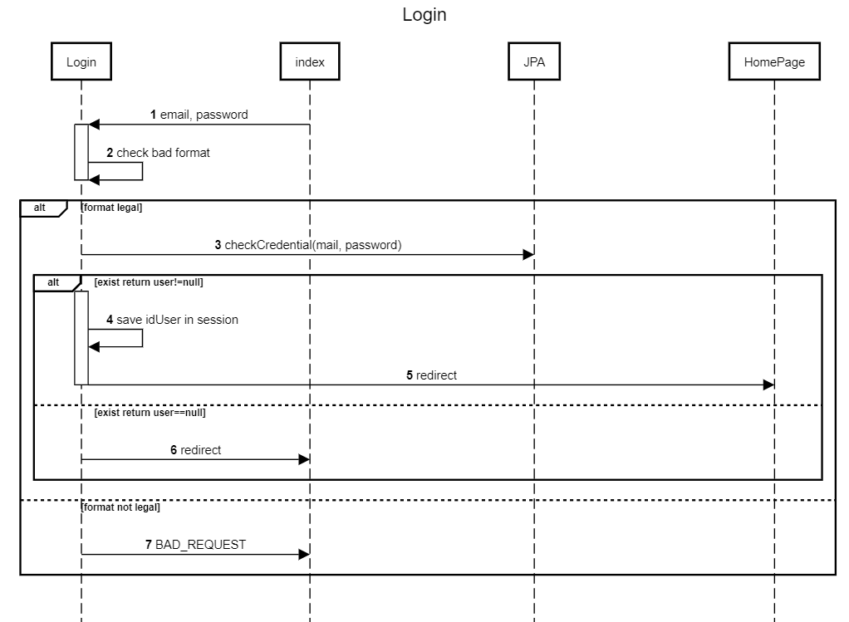
UML Sequence Diagram
Login diagram
Davide Canali – Matteo Cordioli

Slide 48
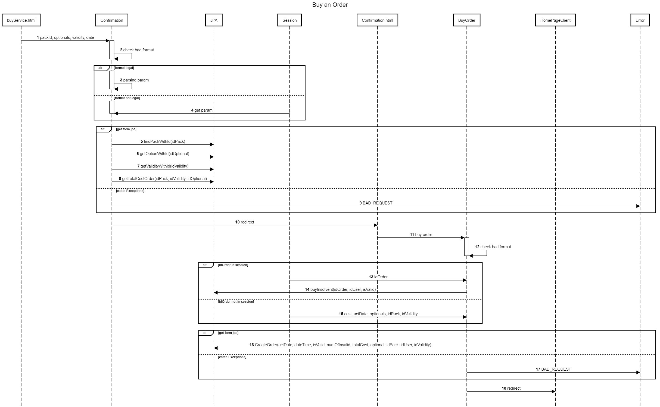
Buy order diagram
Davide Canali – Matteo Cordioli

